Slide 1
Enigmoo (ASCII-based Word EncRYPTION-DecRYPTION)
Ida Bagus Krishna Yoga Utama
Nurian Satya Wardana

Slide 2
ENCRYPTION
[input word]
[secret key]
[encrypted word]

Slide 3
ENCRYPTION
“hello”
“secretKey”
“igopt”

Slide 4
DECRYPTION
[encrypted word]
[secret key]
[decrypted word]

Slide 5
DECRYPTION
“igopt”
“secretKey”
“hello”

Slide 6
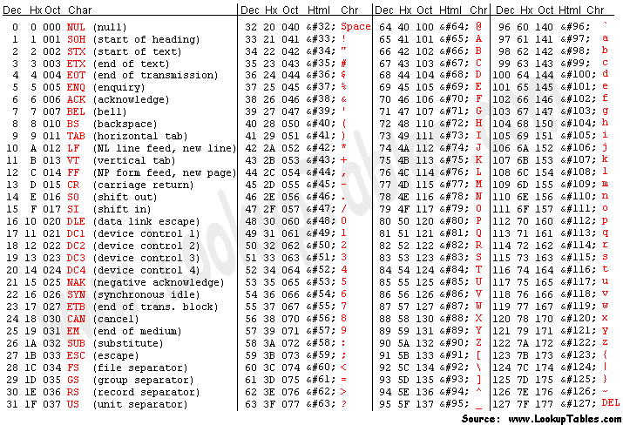
Working principle (Simplified)
Every letters is converted to
its ASCII code representation
Each of those ASCII number
is then subtracted by an
integer X
X is a secret key generated by the program, based on user input

Slide 7
Working Principle (Simplified)
Principle shown here is the simplified version of the algorithm used in the real program.
In the real program, a key is initially generated by sorting user input and pick its median value.
But in subsequent letters, the key is modified in such way that the new key is different from previous.
(encypted letters of “hhh” does not equal “iii”)
This method of encryption does increase complexity but still maintaining reversible operation for decryption
h = 104 → 104 – (-1) = 105 → 105 = i
input
key
output
...repeat for every letter in word

Slide 8
What’s next?
Encrypted and decrypted data is then written to encrypted.txt and decrypted.txt in the same directory of the program (file will be created if not exist).
The program does not modify input file in any way.

Slide 9
Thank you
Ida Bagus Krishna Yoga Utama
Nurian Satya Wardana

